Slide 1


TAXI FARE ANALYSIS

Slide 2
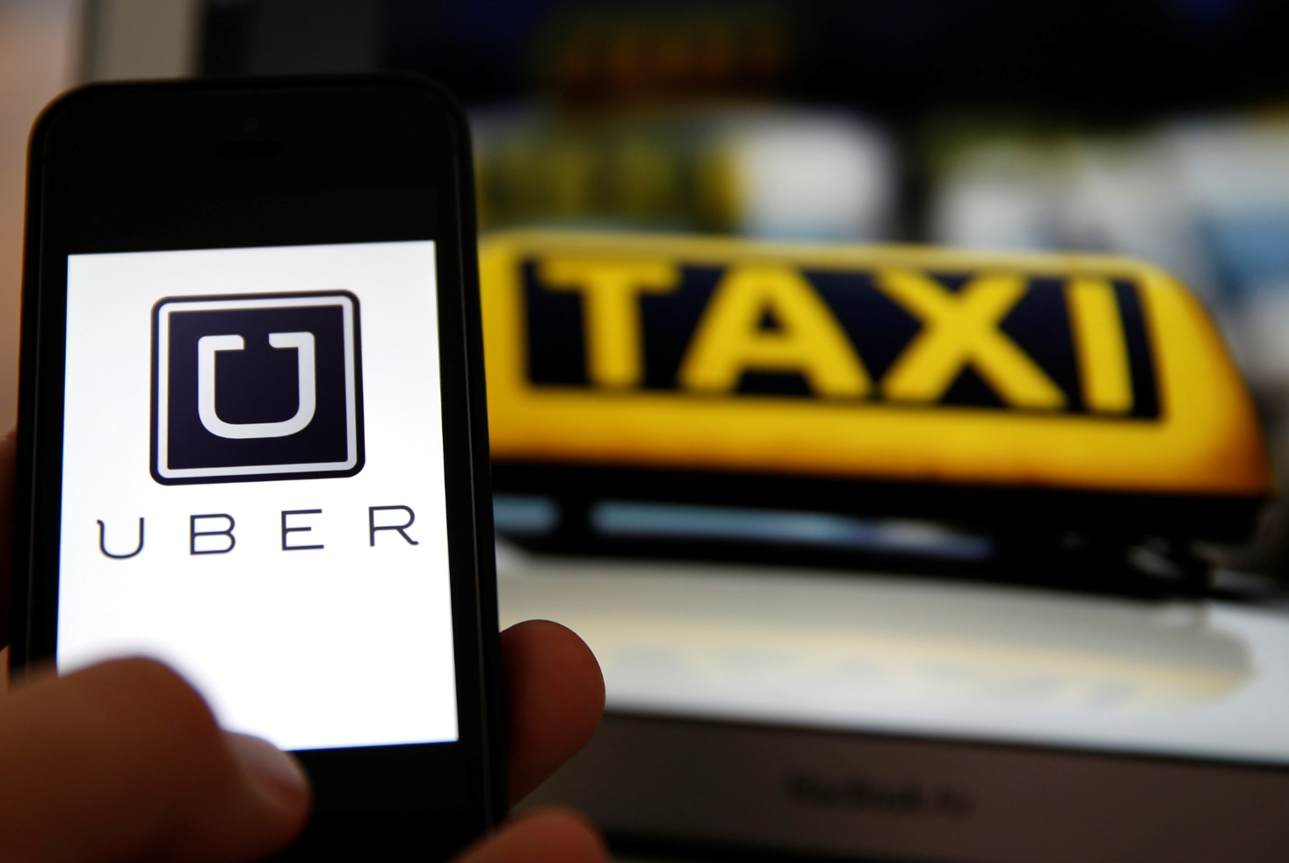
Problem Definition
Question “How Uber generates so much Revenue?”
Aim is to compare and analyze fare data of large number of trips for Taxi Companies mainly New York Yellow Cabs and Uber. Also, verify the Uber estimated fare values. The analysis is focused on New York region only.

Slide 3
Introduction
Analyze how Uber dynamically controls its pricing using the surcharge multiplier parameter.
Uber’s on record rates shown in the App are comparable to other companies but Uber is able to make huge profits using the surcharge it applies.
Ease of Booking the Cab using the App makes the customers lured to using it and Uber takes advantage of this.
We had the dataset of NYC Cabs and we collected the data for same locations for Uber and then compared them.

Slide 4
Dataset
NYC Yellow Taxi Data(Around 143 Million Trips)
For each trip:
Pickup location(Latitude and Longitude)
Dropoff location(Latitude and Longitude)
Distance Travelled(in miles)
Duration of trip(in seconds)
Total Fare (in US Dollars)
Timezone (Range 0 to 23)(Hour Wise)
Example, Timezone 6 means time between 5:30 am to 6:30 am.
4

Slide 5
Data Generation
For initial comparison , we focused on :
Timezone 6 , 10 , 16 , 20.
The Uber Fare API does not have any time as parameter it gives the result on the basis of current time.
We are 9 hours 30 minutes ahead of New York Time.
We picked up the popular locations from the NYC dataset for each specific timezone and threw the query to the Uber API at the appropriate time.
Uber has a lot of product services namely uberPool,uberX,uberXL,uberFAMILY,uberBLACK,uberSUV.
We will focus on UberX ( Cheapest Service of Uber)

Slide 6
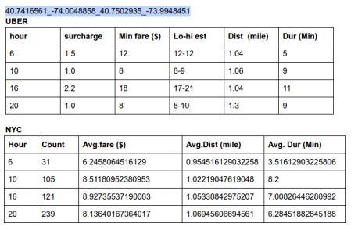
Analyze Data

Slide 7
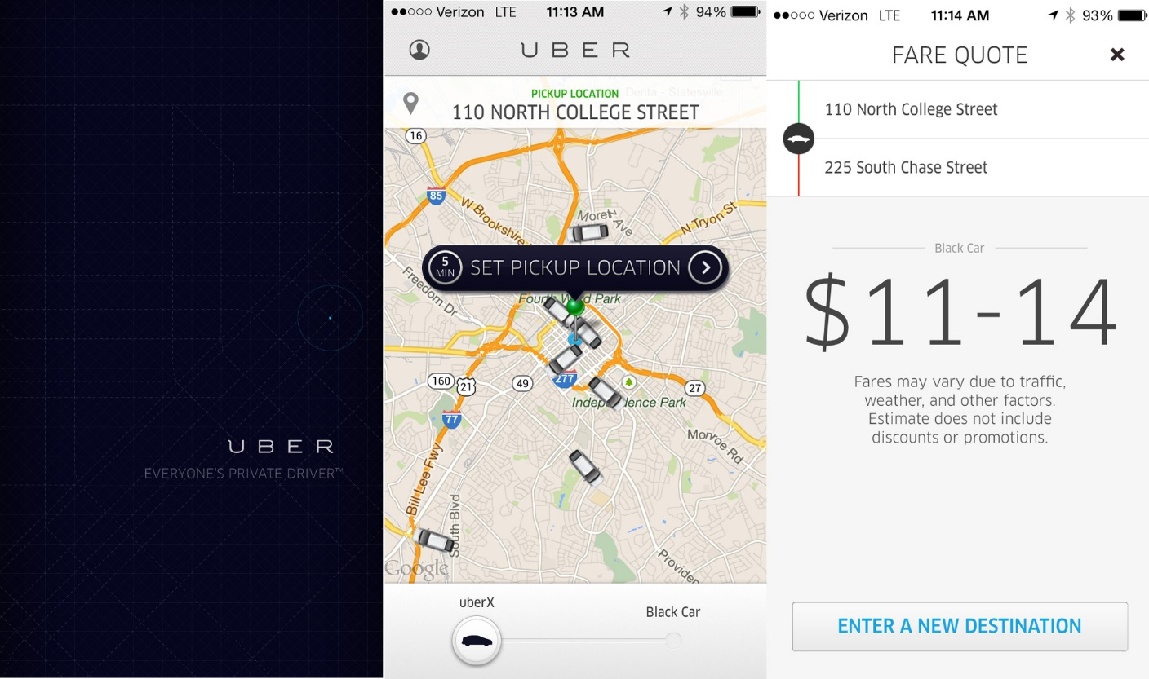
Estimated Fare

Slide 8
Low Estimate and High Estimate
We tried to fit some mathematical formulas and verified them.
For UberX: Base fare: 2.55$ , price/mile = 1.75$ , price/minute = .35$ ,Minimum Fare = 8$.
Low Estimate = Surcharge Multiplier * Minimum Fare
High Estimate = Low Estimate + Some Factor
Time factor = (Time(with traffic) - Time(without traffic)) * price/minute
Distance factor = (Distance(More maybe due to traffic) - Distance(Normal)) * price/distance
Total factor = (Time factor + Distance Factor)*surcharge mulitiplier
These two were verified with the data.

Slide 9
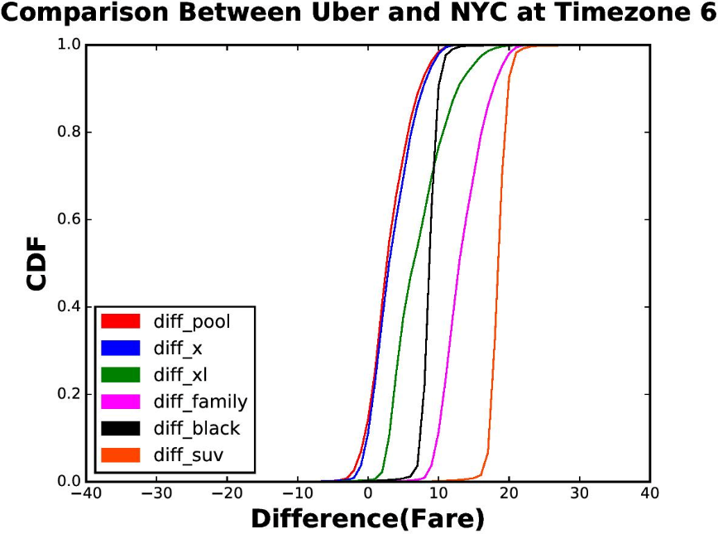
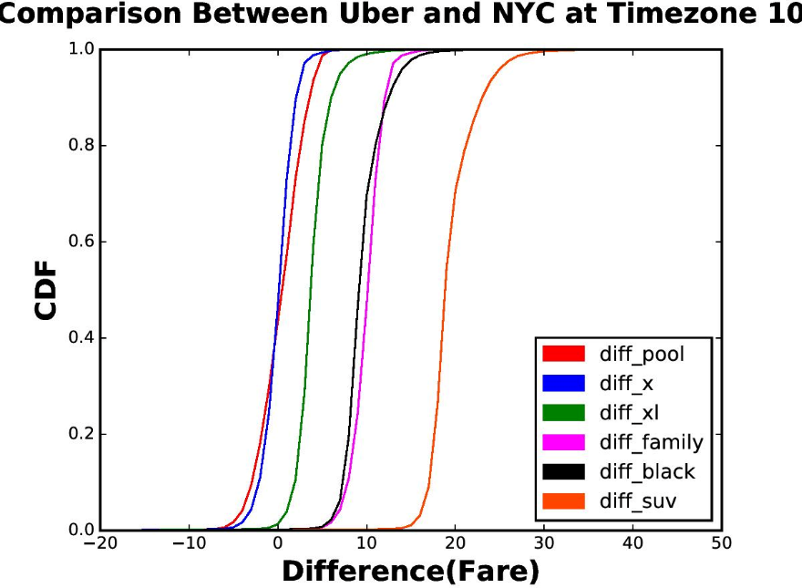
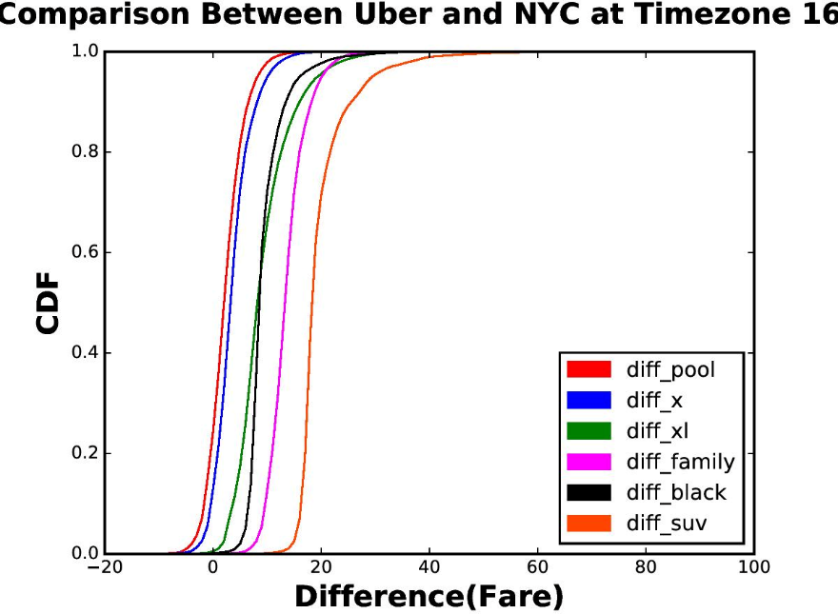
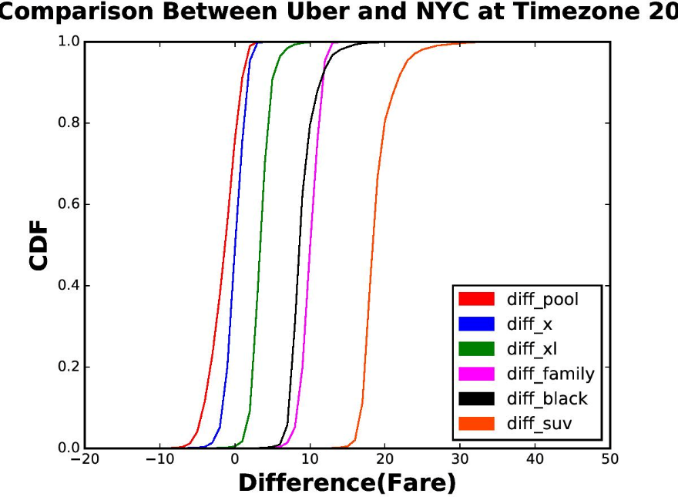
Plots

Slide 10
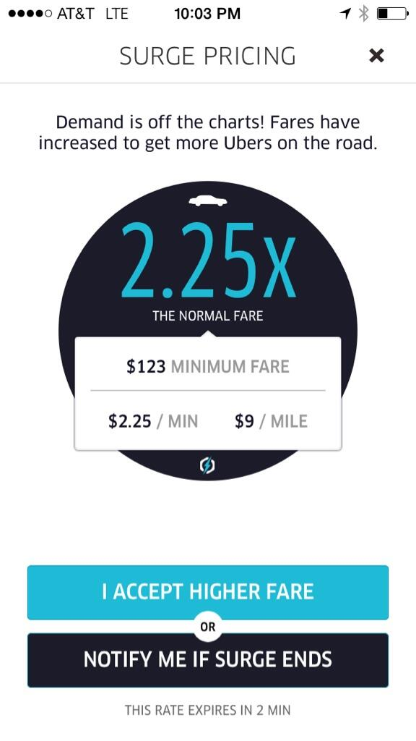
Surcharge
After doing the analysis , Uber earns most of the its money by its dynamically changing Surcharge values.
Surcharge Multiplier =
(Demand By Customers)/(Supply of Drivers).
Can we make a model that will predict the surcharge value using the data we have on giving input ,pickup , dropoff location,timezone and cab service(UberX,UberXL..) ???

Slide 11
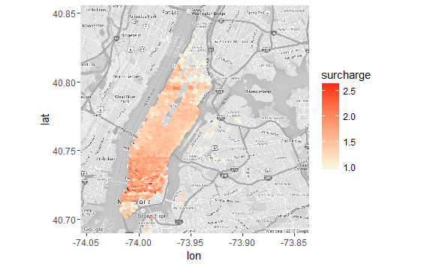
Heatmap(For timezone 16)

Slide 12
Proposed Model
For a particular Timezone and Cab Service

Slide 13
Generating the Training Set
Assuming uniform supply of drivers. Lets us suppose , surcharge only depends on the Demand or Popularity of a particular location.
Fields:
Latitude of pickup location
Longitude of pickup location
Popularity (Counting the number of trips which started at this location in the NYC Dataset)
Average Surcharge of all the trips having this as pickup location

Slide 14
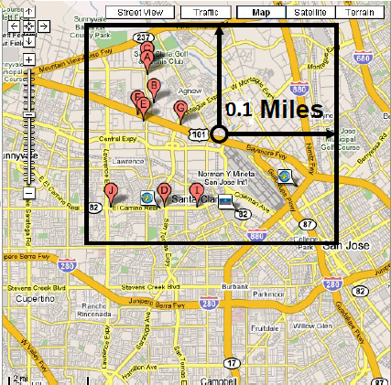
Popularity Estimator
Input is pickup location and timezone.
Assumption: The demand or popularity at a location depends on it locality or near by locations.
We start with a distance of 0.1 mile upto 1 mile till we find atleast one location, and find the nearby locations.
We can take the average of demand of
all locations within the bounding box.
This method did not give good results.

Slide 15


Improvements
Even within the bounding box , the location nearer should have more effect or more weight.
We used Inverse Distance Weighting Average(IDW) .
Distance will the great circle between two points.
This significantly improved our results.
R = 0.1 mile or distance within which we
are calculating. MSE obtained:
Timezone | 6 | 10 | 16 | 20
Normal Avg.
IDW | 0.8957 | 0.8864 | 0.06321 | 9.194

Slide 16
Surcharge Estimator
After estimating the demand at the location , we have to find the estimated surcharge at the location.
We used different regression algorithms which giving input estimated demand gave out estimated surcharge at that location at that timezone. Mean Square Error:
Timezone | 6 | 10 | 16 | 20
Linear Regression | 0.0297 | 0.0221 | 0.0422 | 0.00239
Decision Tree Regression | 0.02813 | 0.01980 | 0.04089 | 0.00231
Support vector Machine Regression | 0.02806 | 0.02850 | 0.03280 | 0.03920

Slide 17

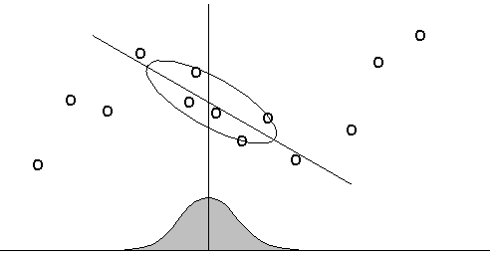



Improvements??
Assumption , estimated value of surcharge should depend on local regions more.
We used Locally Weighted Regression(LWR) in which first the weights are find using the difference of estimated demand to the demand of the near by regions. X0 is the Estimated demand.
Inverse Distance Weighting Function
or Gaussian Function used.

Slide 18
Improved Result
Timezone | 6 | 10 | 16 | 20
LWR | 0.0107 | 0.01092 | 0.0105 | 0.1089

Slide 19
Conclusion
The proposed model estimates the surcharge with maximum of 0.1 .
This model can be useful for the user, he can check the estimated surcharge at his location at that time and see if surcharge decreases maybe after an hour. He can plan his timings accordingly.

Slide 20
Future Work and Recent Changes
The model maybe extended to 24*7 that is can be specialized for a week instead of 24 hours only.
Recently, Uber has launched its different pricing strategy called Upfront Price in very few cities in which Uber tells the User the final price to pay after applying all the taxes and surcharge instead of telling the surcharge multiplier at that time.

